Slide 1
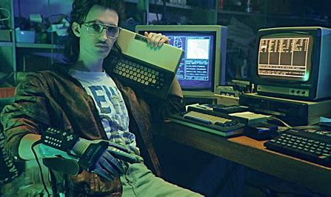
NFL Fantasy Football Mock Draft Simulator
Jayden Slotnick and Payton Glynn

Slide 2
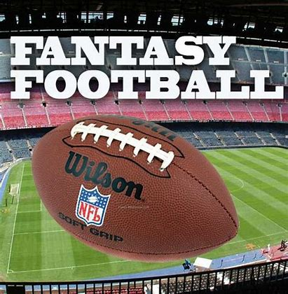
NFL Fantasy Football Mock Draft Simulator
Team: Jayden Slotnick and Payton Glynn
Project description:
Simulates a mock draft for the game of fantasy football
Capabilities
Can run 3 types of drafts
Standard
Points Per Reception (PPR)
Half Points Per Reception (Half-PPR)
Customizable league inputs such as position limits, round limits, and league size
Allows user to have control over one draft slot
Auto-drafts the remainder of the teams with randomness included
Blossary.com. (2013, July 8). Fantasy Football. [Online]. Available: https://www.blossary.com/Blossary:Fantasy_Football_twgid1377857220135678.

